Slide 1

CUnit
Notes:
Software testing includes the sets of activities necessary to discover bugs or defects in a software program that might determine a software to crush or might cause incorrect behaviour

Slide 2
Outline of This Lab
Factorial Example
Install Cunit
Execute testing Projects Successfully
Notes:
Relevant effort for manually porting application code to different platforms or newer versions of the same platform

Slide 3
CUnit
C-based open source framework for writing and running unit tests.
Provides:
Test suites to group test cases
Assertions for testing expected results within a test case
Automates the execution of test cases showing the results

Slide 4
CUnit Installation On Windows
Notes:
Software testing includes the sets of activities necessary to discover bugs or defects in a software program that might determine a software to crush or might cause incorrect behaviour

Slide 5
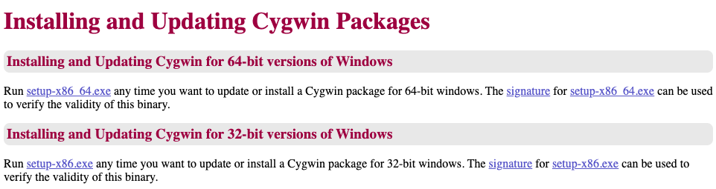
Install Cygwin
Install Cygwin using the link provided at https://cygwin.com/install.html
For 64bit Win select setup-x86_64.exe
For 32bit Win select setup-x86.exe
https://cygwin.com/install.html
Notes:
Relevant effort for manually porting application code to different platforms or newer versions of the same platform

Slide 6
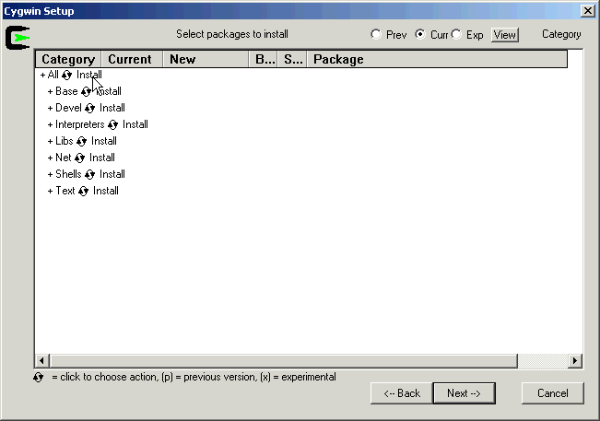
Choosing Packages
You should be able to see packages as classified into categories.
Select and Install CUnit in the category Libs
Notes:
Relevant effort for manually porting application code to different platforms or newer versions of the same platform

Slide 7
CUnit Installation On MacOS
Notes:
Software testing includes the sets of activities necessary to discover bugs or defects in a software program that might determine a software to crush or might cause incorrect behaviour

Slide 8
Install CUnit on MacOS
If you do not have brew installed, open a Terminal and execute the following command:
ruby -e "$(curl -fsSL https://raw.githubusercontent.com/Homebrew/install/master/install)" < /dev/null 2> /dev/null
Then execute the following command:
brew install cunit

Slide 9
CUnit Installation On Linux
Notes:
Software testing includes the sets of activities necessary to discover bugs or defects in a software program that might determine a software to crush or might cause incorrect behaviour

Slide 10
Install CUnit on Linux
Open your terminal and execute the following commands:
sudo apt-get update
sudo apt-get install libcunit1 libcunit1-doc libcunit1-dev
Notes:
Relevant effort for manually porting application code to different platforms or newer versions of the same platform

Slide 11
Configure CUnit
Notes:
Software testing includes the sets of activities necessary to discover bugs or defects in a software program that might determine a software to crush or might cause incorrect behaviour

Slide 12
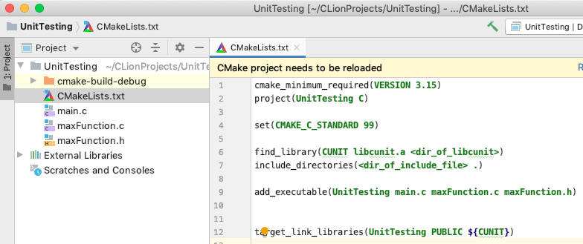
Open One of the Testing Projects Provided On BrightSpace in Clion (Max Function Testing Example)
Open file CMakeLists.txt
Notes:
The output of the architectural design process is an architectural model describing how the system is organised as a set of communicating components

Slide 13
Set-up the directory where your CUnit installation is present
Replace the string <dir_of_libcunit> with the directory where libcunit.a is located. For example:
On a Mac:
/usr/local/Cellar/cunit/2.1-3/lib
On Linux:
/usr/lib/x86_64-linux-gnu/

Slide 14
Set-up the directory where the CUnit header files are located
Replace the string <dir_of_include_file> with the directory of the CUnit header files.
For example:
On MacOS:
/usr/local/Cellar/cunit/2.1-3/include/CUnit
On Linux:
/usr/include/CUnit/

Slide 15
Now Try to Run The Examples
On Brightspace there are 2 Projects:
MaxFunction Testing Example
Triangle Testing Example
What you need to do
Import the projects on CLion and run them successfully (remember to set up CUnit dependencies)
Try the factorial example (described in the rest of the slides)
Notes:
Relevant effort for manually porting application code to different platforms or newer versions of the same platform

Slide 16
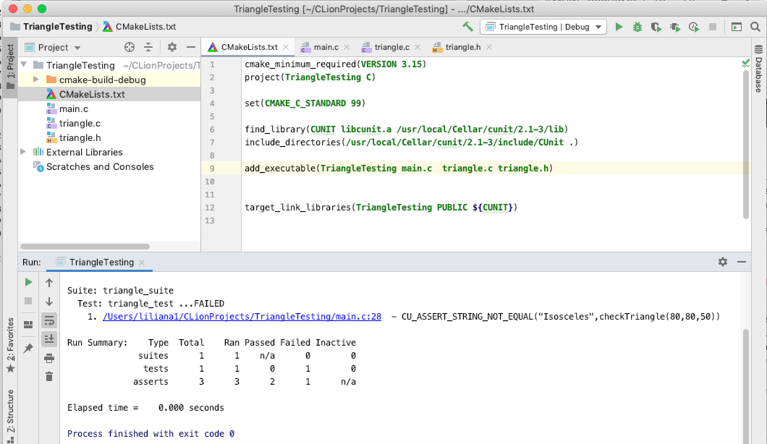
Successful Execution of TriangleTesting Project
Notes:
Software testing includes the sets of activities necessary to discover bugs or defects in a software program that might determine a software to crush or might cause incorrect behaviour

Slide 17
Exercise 1: Testing Factorial
Notes:
Software testing includes the sets of activities necessary to discover bugs or defects in a software program that might determine a software to crush or might cause incorrect behaviour

Slide 18
Method to Test
Suppose you want to verify a method
int factorial(int n)
This method calculates the factorial of a natural number n
Notes:
The major advantage of relying on other systems for patient information is to avoid duplicating data.
The major disadvantage is that it can slow down information access. If such systems are not available the whole system cannot be used.

Slide 19
Method to Test
Suppose you want to verify a method
int factorial(int n)
This method calculates the factorial of a natural number n
What inputs do you need to verify this method?
What assertions you might need to verify?
Notes:
The major advantage of relying on other systems for patient information is to avoid duplicating data.
The major disadvantage is that it can slow down information access. If such systems are not available the whole system cannot be used.

Slide 20
Method to Test
Suppose you want to verify a method
int factorial(int n)
This method calculates the factorial of a natural number n
What inputs do you need to verify this method?
Normal values: 4
Boundary values: 0, 1
What assertions you might need to verify?
Notes:
The major advantage of relying on other systems for patient information is to avoid duplicating data.
The major disadvantage is that it can slow down information access. If such systems are not available the whole system cannot be used.

Slide 21
Method to Test
Suppose you want to verify a method
int factorial(int n)
This method calculates the factorial of a natural number n
What inputs do you need to verify this method?
Normal values: 4
Boundary values: 0, 1
What assertions you might need to verify?
Factorial of 4 is 24
Factorial of 0 and 1 is 1
Notes:
The major advantage of relying on other systems for patient information is to avoid duplicating data.
The major disadvantage is that it can slow down information access. If such systems are not available the whole system cannot be used.

Slide 22
Create the Source Files Containing the Implementation of the Method to Test
Open your IDE and create a C Project (e.g., Factorial)
Inside this project define a c Source file factorial.c as follows
#include “factorial.h”
int factorial(int n) {
//precondition: n >0
int fact; //factorial of n
int i; //to iterated between 1 and n
/*calculates factorial of n */
fact = 1;
for(i=1; i<n; i++) {
fact *= i;
}
return fact;
}
Notes:
The major advantage of relying on other systems for patient information is to avoid duplicating data.
The major disadvantage is that it can slow down information access. If such systems are not available the whole system cannot be used.

Slide 23
Contain the Header File Including the Function Declaration
Inside the Factorial project define a header file factorial.h containing the following line
int factorial(int n);
Notes:
The major advantage of relying on other systems for patient information is to avoid duplicating data.
The major disadvantage is that it can slow down information access. If such systems are not available the whole system cannot be used.

Slide 24
Test the Factorial Function
Now let’s test the Factorial function
Download the file testFactorial.c on Brightspace
Import testFactorial.c in the Factorial project
Remember to configure the dependencies with CUnit libraries in your project
Notes:
The major advantage of relying on other systems for patient information is to avoid duplicating data.
The major disadvantage is that it can slow down information access. If such systems are not available the whole system cannot be used.

Slide 25
Design the Test Cases for the Factorial Function
void factorial_testcase1(void){
CU_ASSERT_EQUAL(factorial(0),1 );
/* insert here 2 assertions necessary
* to verify whether the factorial of 1 is 1
* and whether the factorial of 4 is 24
*/
}
The test case in testFactorial.c only has 1 assertion that verifies if the factorial of 0 is 1
Run the CLion project
Notes:
The major advantage of relying on other systems for patient information is to avoid duplicating data.
The major disadvantage is that it can slow down information access. If such systems are not available the whole system cannot be used.

Slide 26
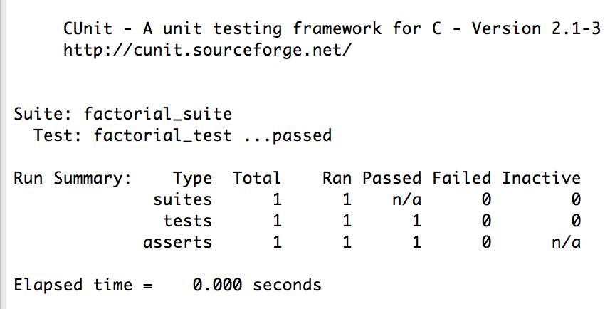
The Test Case is Successful
Notes:
The major advantage of relying on other systems for patient information is to avoid duplicating data.
The major disadvantage is that it can slow down information access. If such systems are not available the whole system cannot be used.

Slide 27
Design the Test Cases for the Factorial Function
void factorial_testcase1(void){
CU_ASSERT_EQUAL(factorial(0),1 );
/* insert here 2 assertions necessary
* to verify whether the factorial of 1 is 1
* and whether the factorial of 4 is 24
*/
}
Insert 2 additional assertions as prescribed and run the test case again.
Notes:
The major advantage of relying on other systems for patient information is to avoid duplicating data.
The major disadvantage is that it can slow down information access. If such systems are not available the whole system cannot be used.

Slide 28
Design the Test Cases for the Factorial Function
void factorial_testcase1(void){
CU_ASSERT_EQUAL(factorial(0),1 );
CU_ASSERT_EQUAL(factorial(1),1 );
CU_ASSERT_EQUAL(factorial(4),24 );
}
Notes:
The major advantage of relying on other systems for patient information is to avoid duplicating data.
The major disadvantage is that it can slow down information access. If such systems are not available the whole system cannot be used.

Slide 29
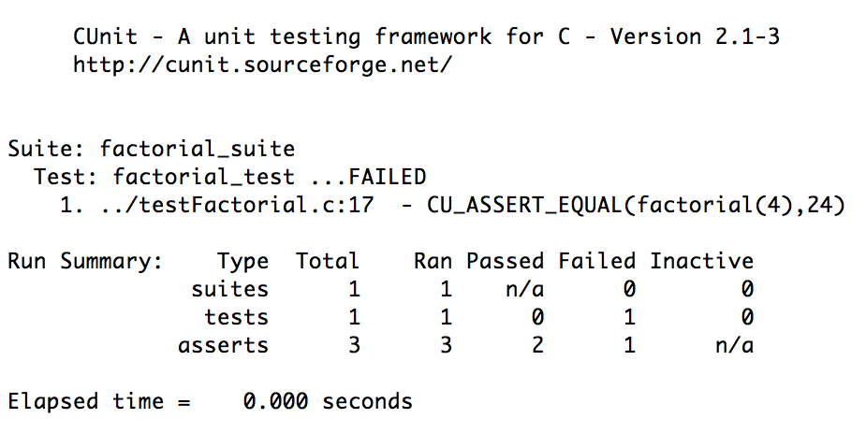
One of the Assertions Fails
Notes:
The major advantage of relying on other systems for patient information is to avoid duplicating data.
The major disadvantage is that it can slow down information access. If such systems are not available the whole system cannot be used.

Slide 30
Let’s Fix the Error inside factorial.c and Run the Test again
int factorial(int n) {
//precondition: n >0
int fact; //factorial of n
int i; //to iterated between 1 and n
/*calculates factorial of n */
fact = 1;
for(i=1; i<=n; i++) {
fact *= i;
}
return fact;
}
Notes:
The major advantage of relying on other systems for patient information is to avoid duplicating data.
The major disadvantage is that it can slow down information access. If such systems are not available the whole system cannot be used.

Slide 31
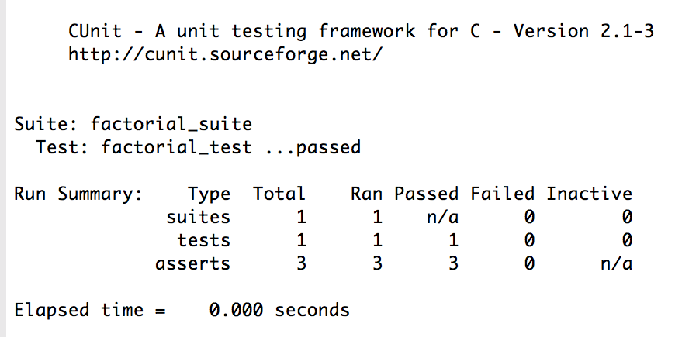
Now the Test is Successful
Notes:
The major advantage of relying on other systems for patient information is to avoid duplicating data.
The major disadvantage is that it can slow down information access. If such systems are not available the whole system cannot be used.

